Slide 1
Indirect Purchase Order
Create Purchase Order- ME21N
Goods Receipt- MIGO
Incoming Invoice- MIRO

Slide 2
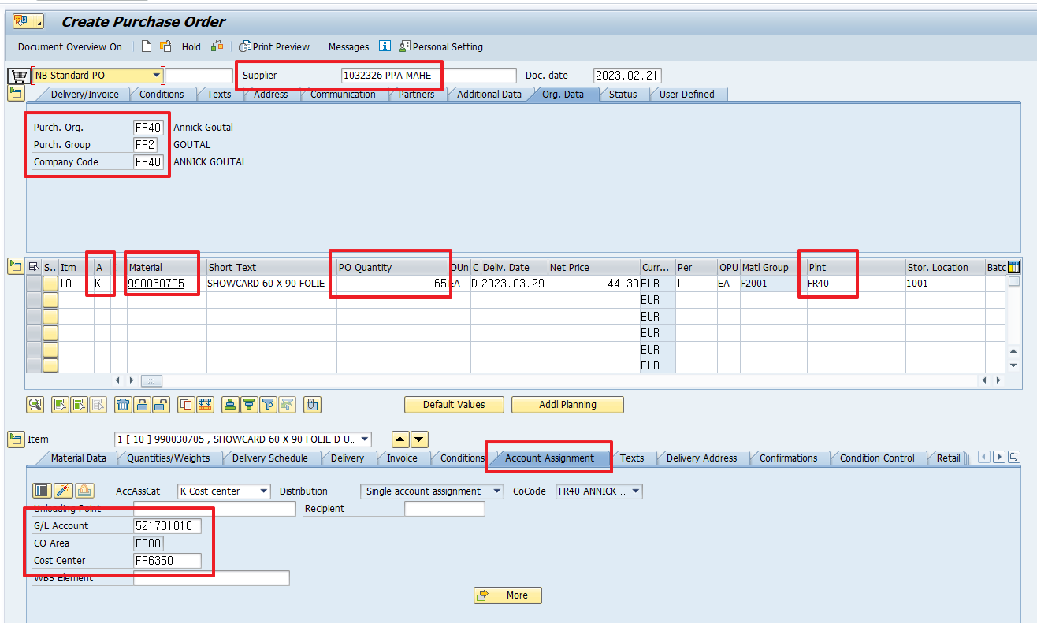
Create Purchase Order- ME21N
Local Purchase Order Process
1
2
2
4
3
3
3
4
1. Select the purchase order type NB Standard PO.
2. After entering Vendor, enter the purchase organization, purchase group, and company code of Org. Data.
3. Enter the purchase material number, purchase quantity, delivery date, price, warehousing plant, and warehousing storage location and check the details. Perform PO for PCM1 PCM2 material type.
4. In the case of PCM1 material type, only the quantity is registered in the master without unit price, so you must enter the item category K and enter the account.
5. Click to save the purchase order.

Slide 3
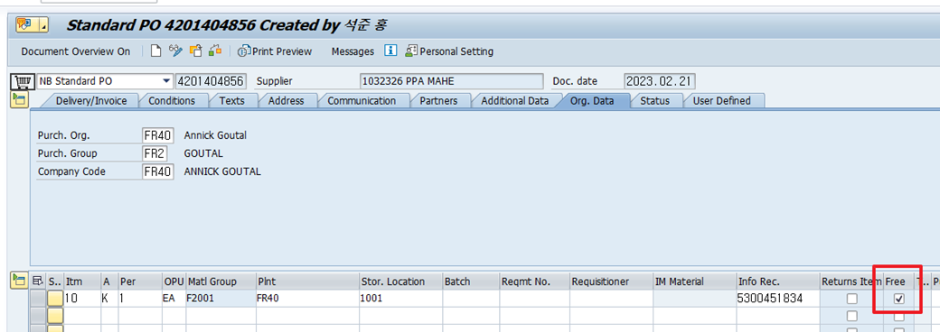
Create Purchase Order- ME21N
Local Purchase Order Process
1
If it's free, check for Free.
If you check free of charge, the linked G/L account will not be charged.

Slide 4
Indirect Purchase Order
Create Purchase Order- ME21N
Goods Receipt- MIGO
Incoming Invoice- MIRO

Slide 5
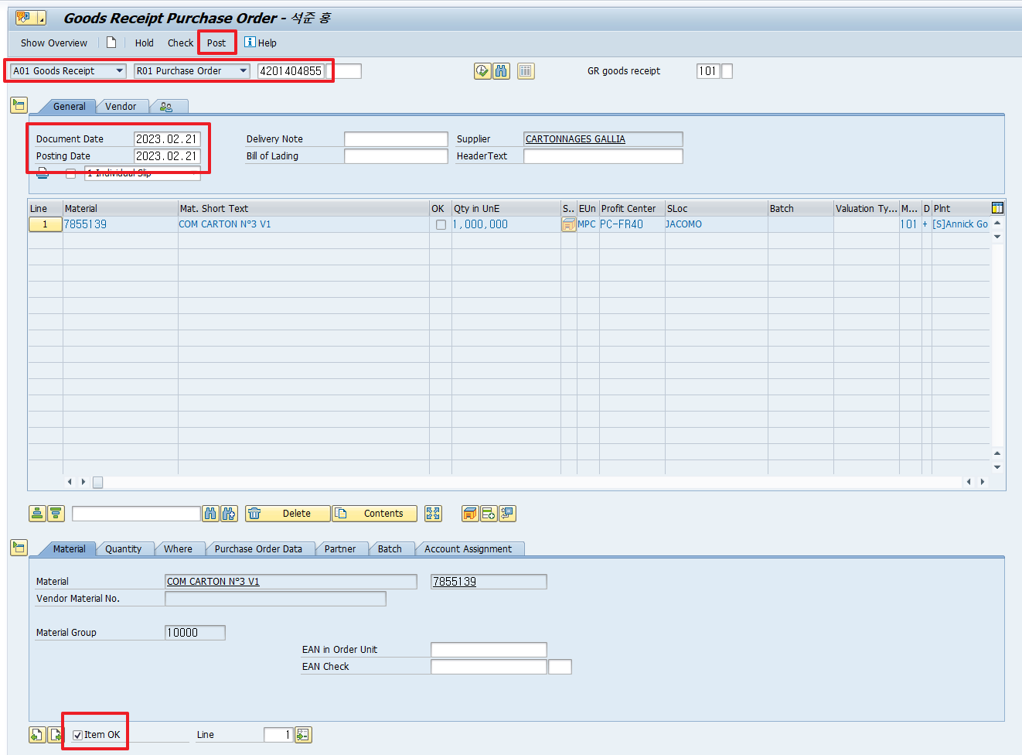
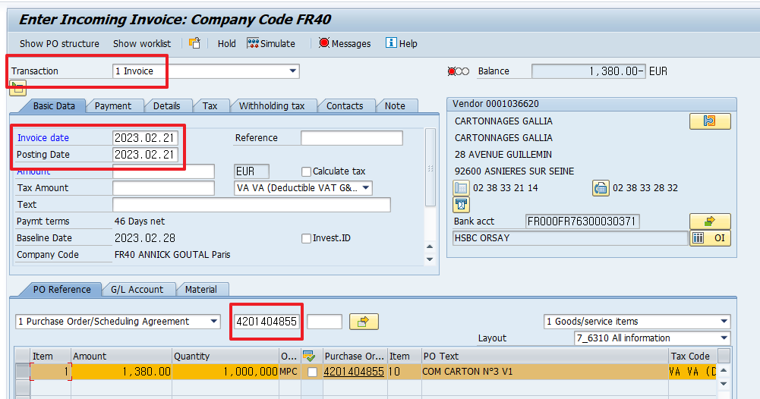
Goods Receipt- MIGO & Incoming Invoice- MIRO
Local Purchase Order Process
4
1
2
1
2
3
3
Proceed in the same manner as above.

