Slide 1
MM_Incoming Invoice-Subsequent Settlement (MIRO) manual

Slide 2
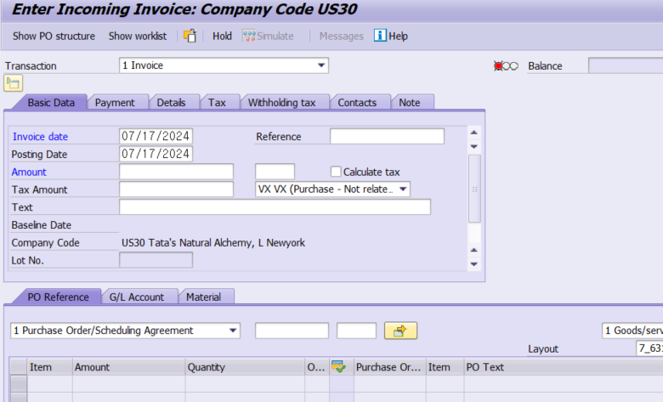

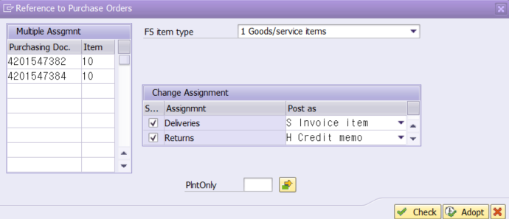
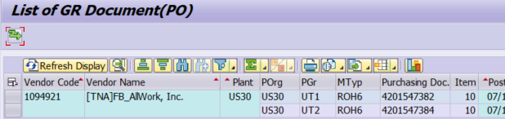
Enter Incoming Invoice (Subsequent Settlement) (T-code: MIRO)
6.7.1.10 Subsequent Settlement-TNA
Screen
Explanation
[Entry of Subsequent Settlement Document]
A transaction to processes a large number of subsequent settlement documents by referring to the PO
- The reference PO of subsequent settlement can be processed after the IV document.
- For local PO, it is applied retroactively, and for overseas PO, it is used when settling incidental charges.
Open the dropdown list in the transaction and select “3 Subsequent Debit” or “4 Subsequent Credit.”
Refer to the invoice received, input the Invoice date and Posting Date.
Click the button to input the reference PO number and the button to get the PO information.
- In List of GR Document (ZMM40020), copy and paste the Purchase Doc. and item numbers to be invoiced.
/
1
2
3
ZMM40020

Slide 3
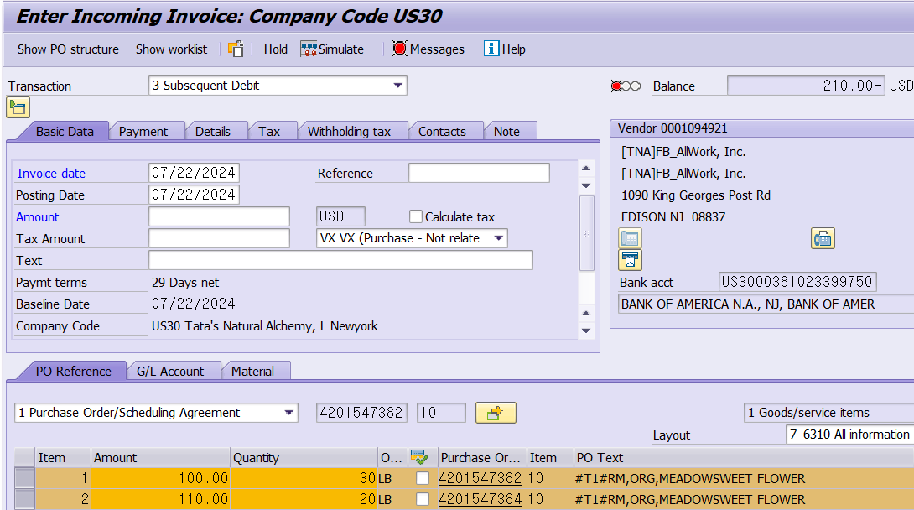
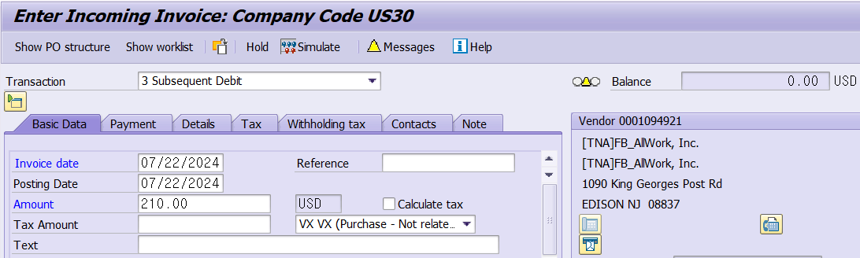
Enter Incoming Invoice (Subsequent Settlement) (T-code: MIRO)
6.7.1.10 Subsequent Settlement-TNA
Screen
Explanation
[Entry of Subsequent Settlement Document]
A transaction to processes a large number of subsequent settlement documents by referring to the PO
- The reference PO of subsequent settlement can be processed after the IV document.
- For local PO, it is applied retroactively, and for overseas PO, it is used when settling incidental charges.
Only GR quantity is auto-suggested from the referenced PO information.
- The amount of subsequent settlement is entered directly.
The total sum of the selected line items is auto-suggested as the Balance in the upper right corner.
To match the debit/credit amount, copy and paste the balance into the header amount.
Balance status changes from to or .
Reference & Text (optional)
- Provide summary if necessary.
2
1
4
5
3
5

Slide 4
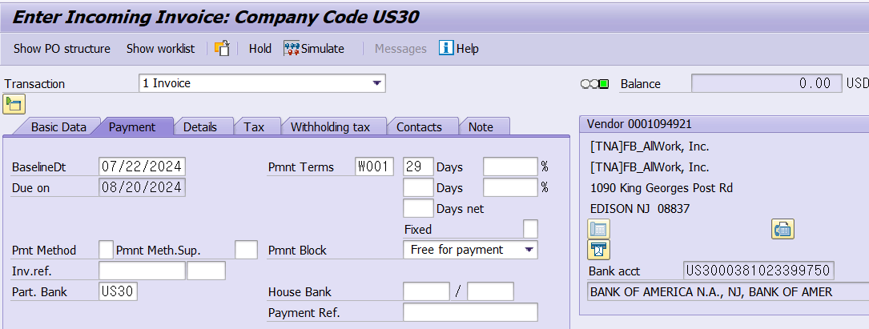
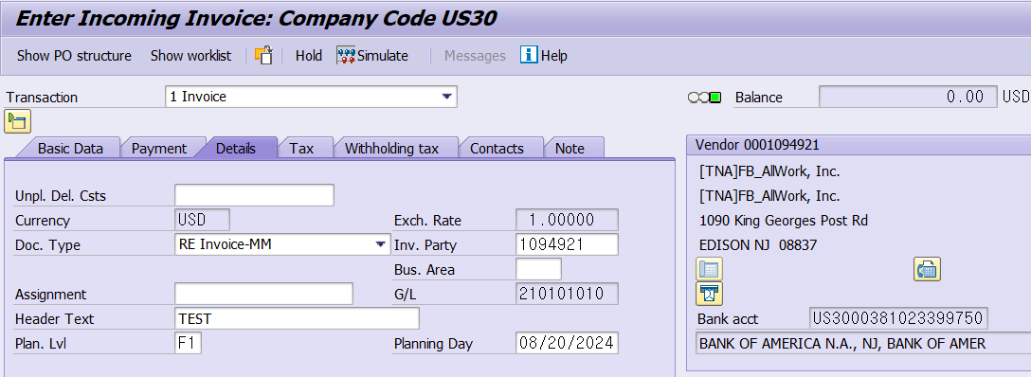
Enter Incoming Invoice (Subsequent Settlement) (T-code: MIRO)
6.7.1.10 Subsequent Settlement-TNA
Screen
Explanation
[Entry of Subsequent Settlement Document]
A transaction to processes a large number of subsequent settlement documents by referring to the PO
- The reference PO of subsequent settlement can be processed after the IV document.
- For local PO, it is applied retroactively, and for overseas PO, it is used when settling incidental charges.
Payment
1) Payment Terms (mandatory): The payment term in the vendor master is auto-suggested. Change if needed.
2) Partner Bank Type (mandatory for Firm Banking)
Details
1) Unplanned Delivery Costs (optional)
- It is used to reflect incidental charges on the overall PO.
- Auto-split in proportion to the amount of the PO line item
- Auto-reflected in the total balance if entered
2) Invoicing Party (mandatory)
- The PO vendor is auto-suggested but can be changed if the payee is different from the PO vendor.
3) Header Text (mandatory)
- Provide summary.
1
1)
2)
2
1)
2)
3)

Slide 5
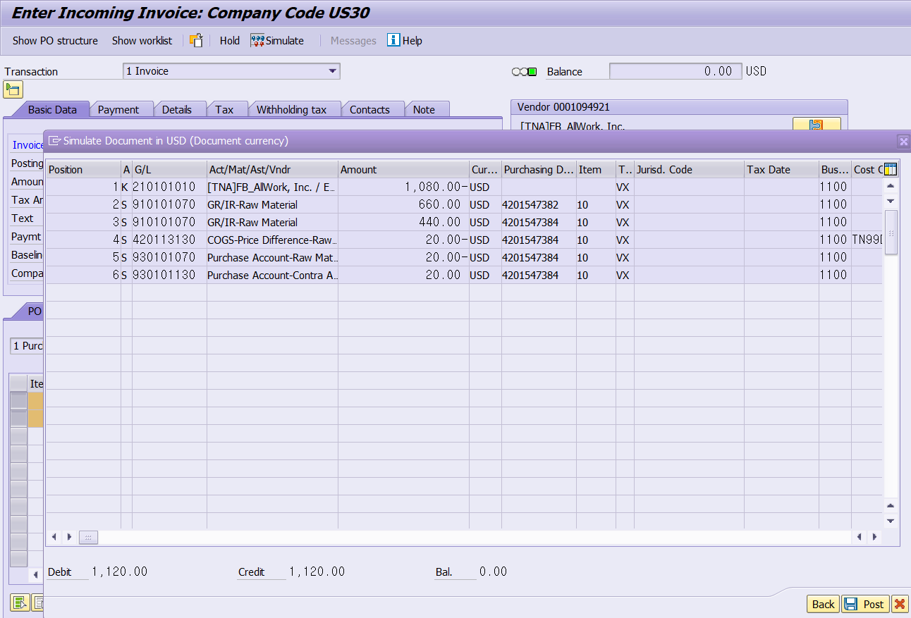
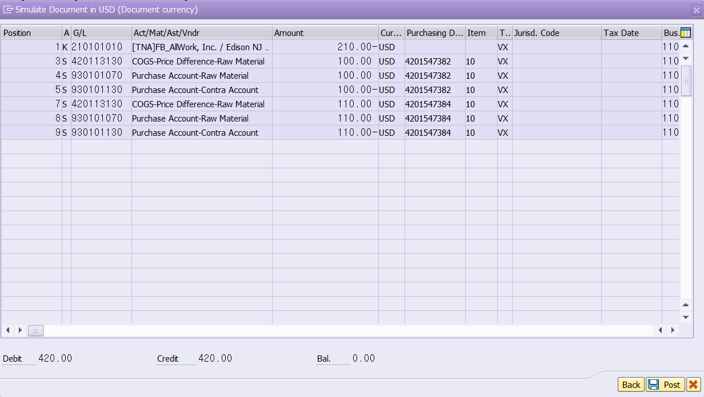
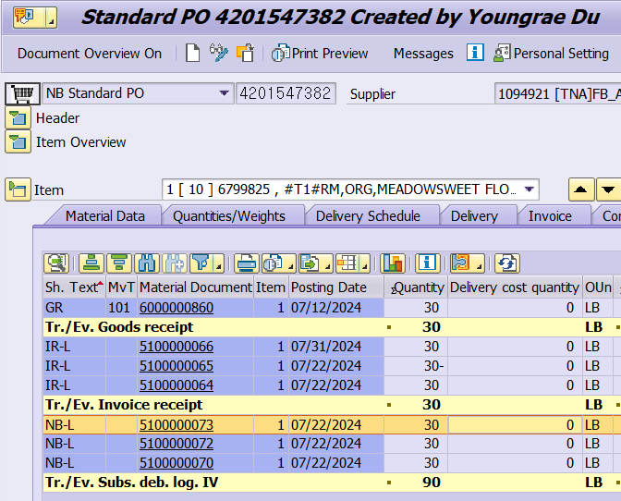

Enter Incoming Invoice (Subsequent Settlement) (T-code: MIRO)
6.7.1.10 Subsequent Settlement-TNA
Screen
Explanation
[Entry of Subsequent Settlement Document]
A transaction to processes a large number of subsequent settlement documents by referring to the PO
- The reference PO of subsequent settlement can be processed after the IV document.
- For local PO, it is applied retroactively, and for overseas PO, it is used when settling incidental charges.
Simulation
- Click the button to check if the information entered is correct.
Click the Post button to post an IV document.
In the event of an error, the Message button will be displayed in red, and users can check the detailed error message by clicking it.
Users can check the debit entries of the subsequent settlement document via PO History. (ME23N)
1
3
2
4

