Slide 1
Analysis Office User Manual
ITO SAP

Slide 2
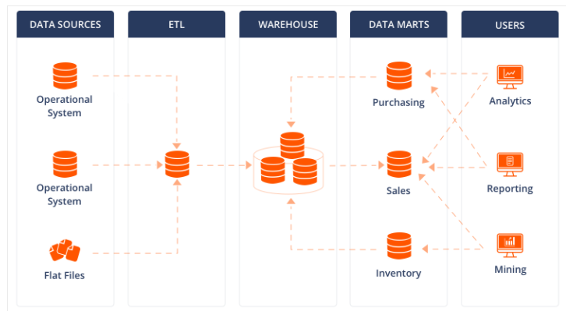
1-1. What is SAP BW / BI?
Business Warehouse
Business Intelligence

Slide 3

1-2. AMOREPACIFIC BI Architecture
Analysis
Office
BI EIS
Mobile EIS
AP Cube
. . .
BWP
CDP
(HQ POS Sales)
Excel File
(Manual Upload)
Global POS
GQMS
(Claim system)
ECC
EWM
APO
.
.
SAP Systems
Non-SAP Systems

Slide 4
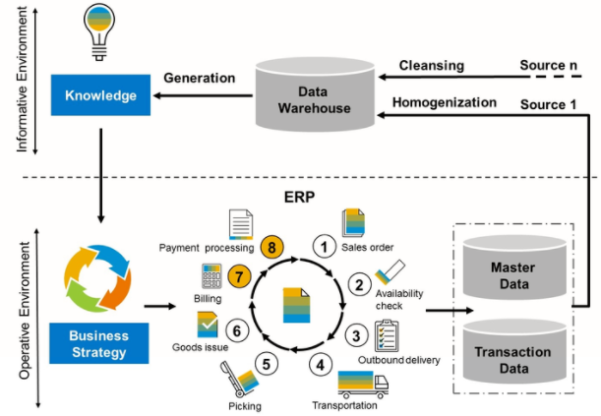
1-3. SAP Data Cycle

Slide 5
1-4. Object Modeling
Report
Info Object
DSO
(Data Store Object)
CP
(Composite Provider)
Master Characteristic
Characteristics
DSO
Cube
Key / Text
characteristic
DSO
characteristic
DSO
Attribute
…
characteristic
DSO
…
Key Figures
Key Figures
DSO
Amount / Unit
Key Figures

Slide 6
1-5. Cube Area & Report Naming Rule
[SD] Sales
[ZSD_001] Net Sales
[ZSD_002] Sales Order & Billing
[ZSD_702] POS Sales
…
[CO] Controlling
[ZCO_408] New P&L
[ZCO_402] Old P&L
[ZCO_701] Inventory Aging
…
[Report Naming Rule]
S_ZSD_001_Q0058
[Std] Net Sales by Brand/Channel
[SCM] Supply Chain
[ZCM_002] Inventory
…
[MM] Material Management
[ZMM_011] Material Movement
…
Report Type
S: Standard (Created by admin)
Z: Personal (Created by general user)
Cube Name
[FI] Financial
[ZFI_201] Financial Statement
…
[MD] Master
[ZMD_006] Material Master
…
Sequence Number

Slide 7
1-6. Simple Example
SAP ECP
SAP BW
Material
Material number
Brand Group
Material Usage
…
Cube
Master Characteristic
[ZCM_002] [SCM] Inventory
Material
[0CALDAY] Calendar Day
Brand Group
[0STOR_LOC] Storage Location
Material Usage
[0STOR_LOC__ZSTORTYPE] Storage Location Type
Storage Location
Storage Location
Storage location Type
…
Storage Location
[0MATERIAL] Material
Storage Location Type
[0MATERIAL__ZBRANG] Brand Group (N)
[0MATERIAL__0MATL_GRP_1] Material Usage (N)
[ZCNSTCQTY] Stock Quantity
Transaction Data
[DMM_001] [MM] Daily Stock
Daily Stock quantity
Calendar Day
Storage Location
Material number
Stock quantity
…
[0CALDAY] Calendar Day
Report
[0STOR_LOC] Storage Location
[0MATERIAL] Material
Date | Storage | Material | Brand Group | Stock Quantity
[ZCNSTCQTY] Stock Quantity

Slide 8
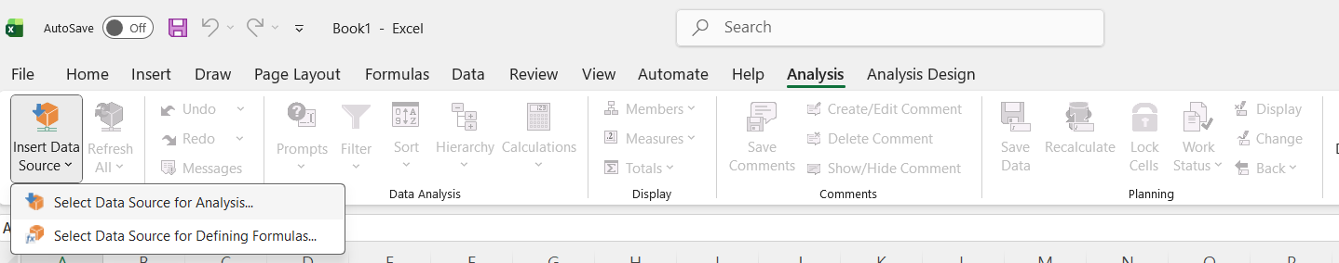
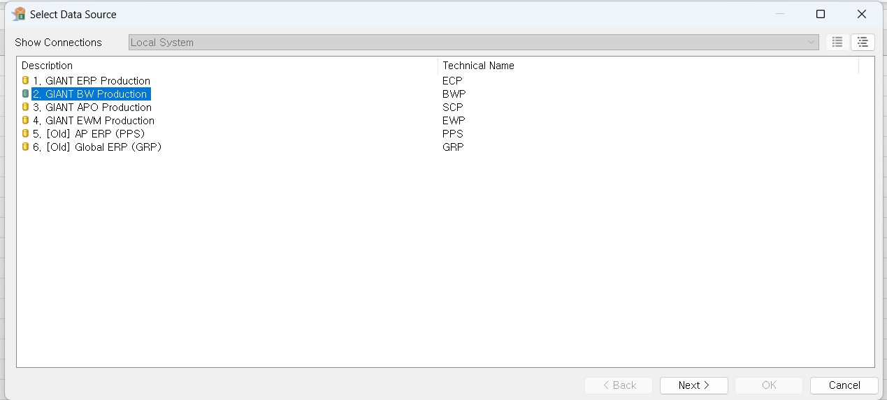
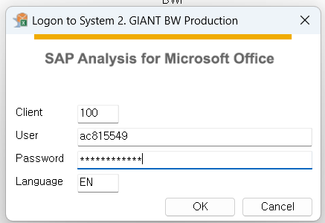
User Manual
Log-on the service
Go to Analysis > Select Data Sources > Insert Data source for Analysis
Select BWP server on the list, Enter your credentials.
- Cline : 100
- Language : EN

Slide 9
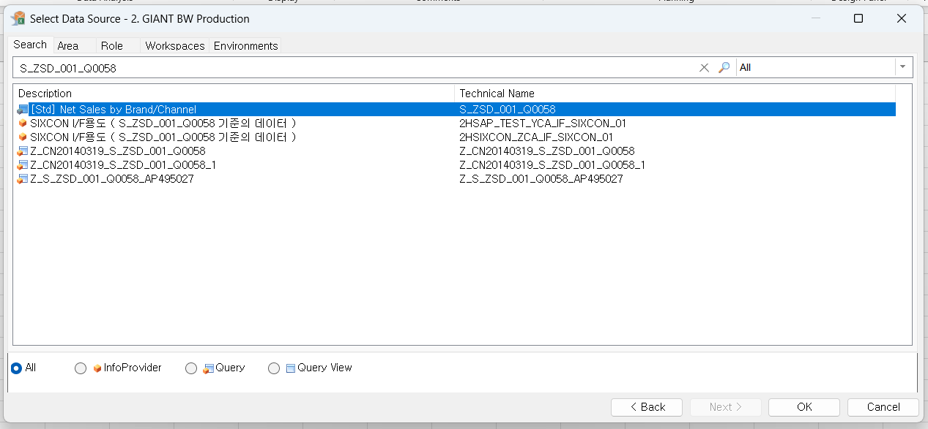
User Manual
Search the report
You can search report with technical name & description.
[Search]
Main Report
- Net Sales : S_ZSD_001_Q0058 [Std] Net Sales by Brand/Channel
- Stock : S_ZCM_002_Q0053 [Std] Stock & Slow moving
- POS Sales : S_ZSD_702_Q0013 [Std] Sell-Thru Analysis by POS receipt
- P&L : S_ZCO_408_Q0001 [Std] New P&L

Slide 10
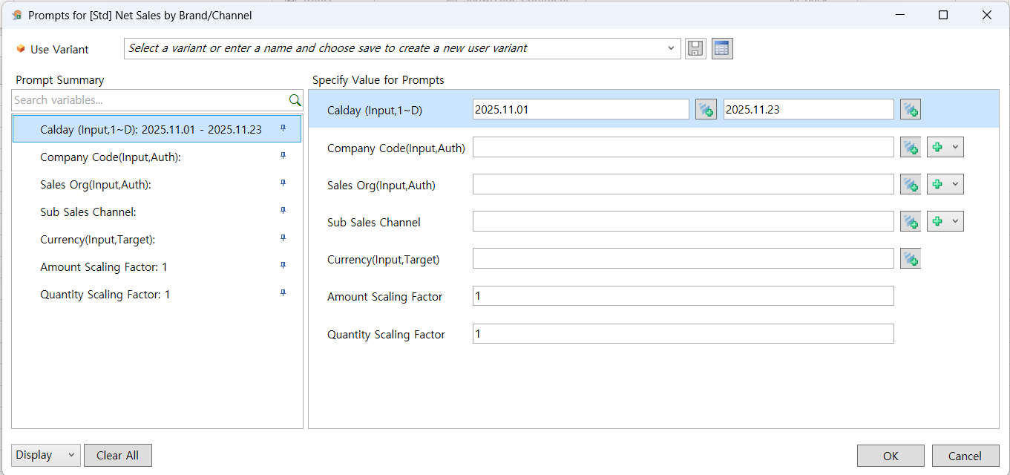
User Manual
Prompts
Notes:
[주의사항]
프롬프트에서 지정된 범위만큼 서버에서 데이터를 내려 받기 때문에, 성능을 고려하여 적절한 범위로 설정하여 실행 하시길 바랍니다.
회사 코드와 영업조직 기준으로 권한 관리가 이루어지기 때문에 잘못된 코드가 입력되었거나, 아예 조건을 입력하지 않으신 경우
권한 문제가 발생하실 수 있습니다. (입력되지 않은 경우 전체 법인 권한 점검)

Slide 11
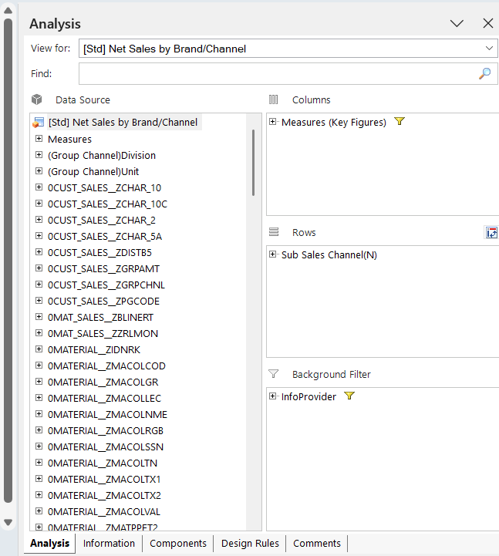
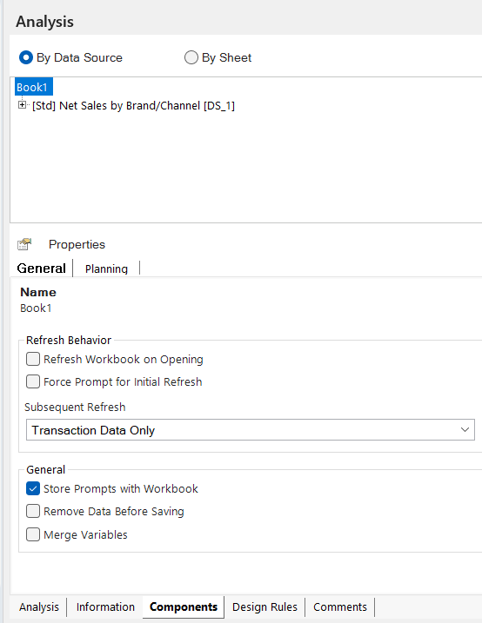
User Manual
Design Panel
[Analysis] [Components]

Slide 12
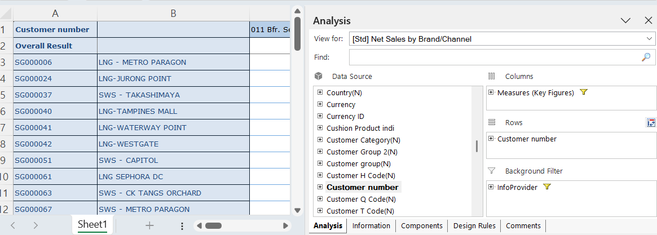
User Manual
Drill Down

Slide 13
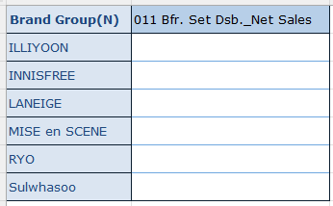

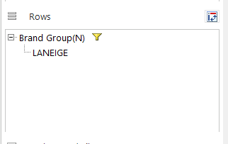

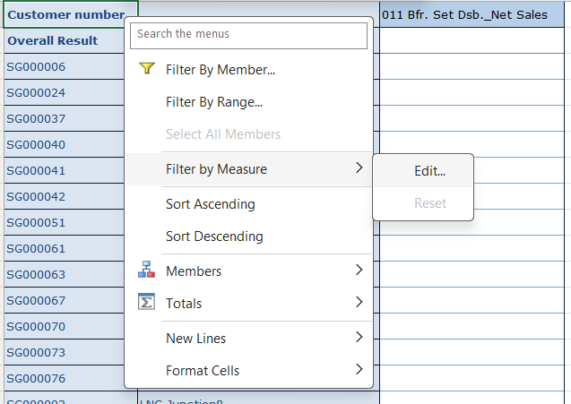
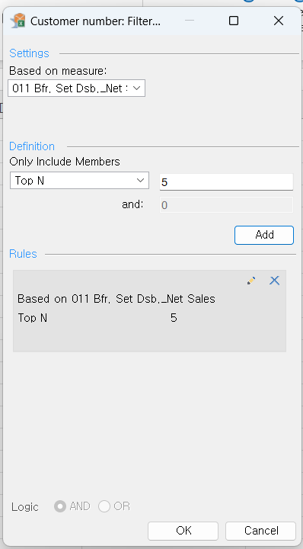
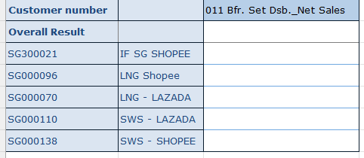
User Manual
Filter by Member
Filter by Measure

Slide 14
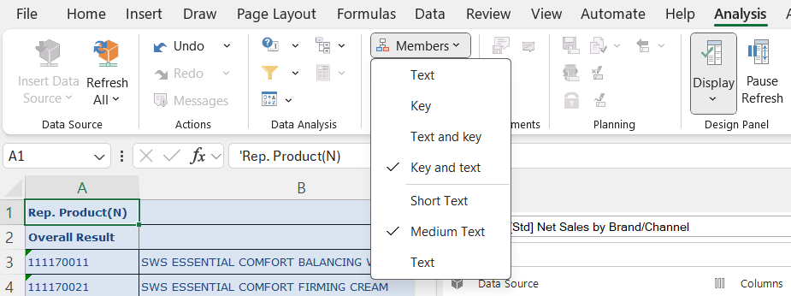
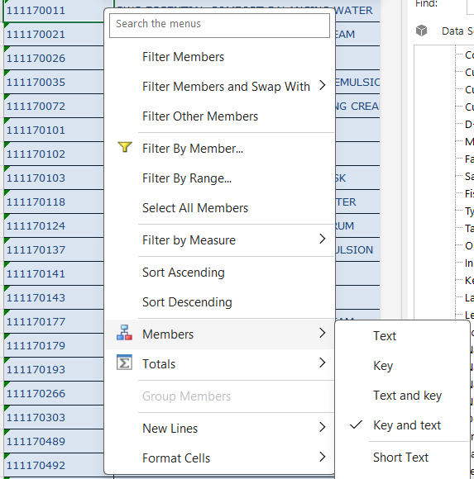
User Manual
Key & Text
You can choose display option for characteristic. ( Key / Text / Key & Text )
[Option 1]
Choose characteristic on your report.
Change display option at Analysis tab > Member.
[Option 2]
Right Click on characteristic
Change display option at Member.

Slide 15
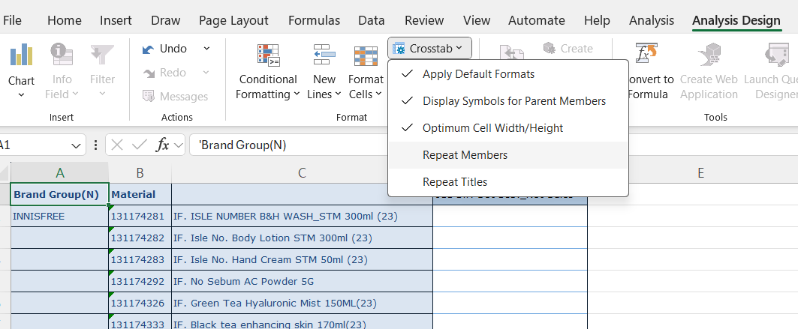
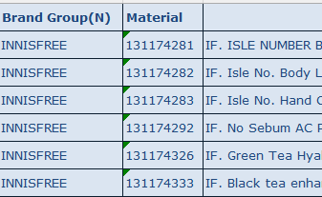
User Manual
Repeat Members
BI Report shows text information only 1 time for same data level. (Default Option)
But If you need to fill-out text information for all lines, you can activate “Repeat Members” or “Repeat Titles” option
[Option] Analysis Design > Crosstab > Repeat Members

Slide 16
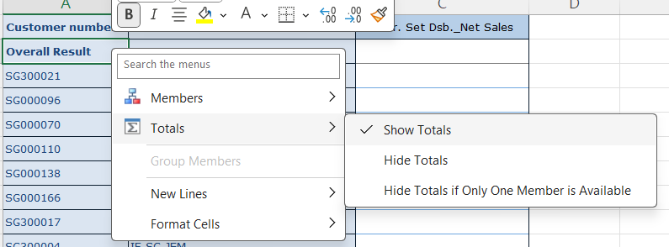
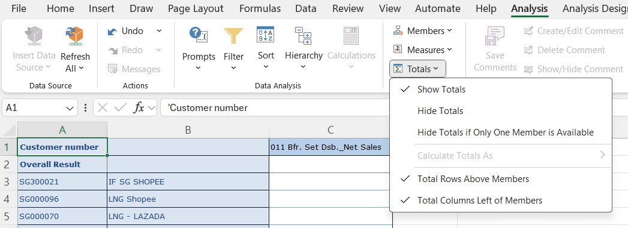
User Manual
Total
You can change total option for each characteristic.
[Option 1] Right click on “Overall Result” > Totals > Change total option.
[Option 2] Choose your characteristic, Change option at Analysis > Totals.

Slide 17
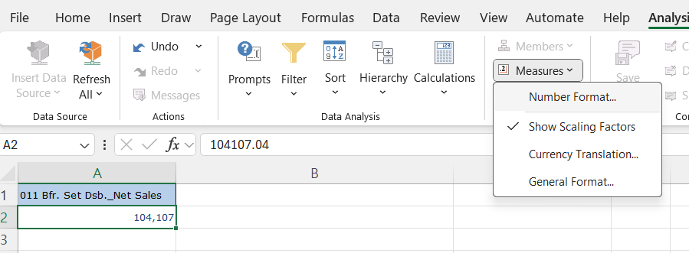
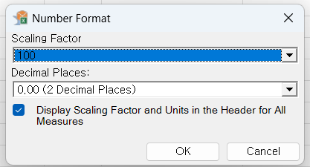
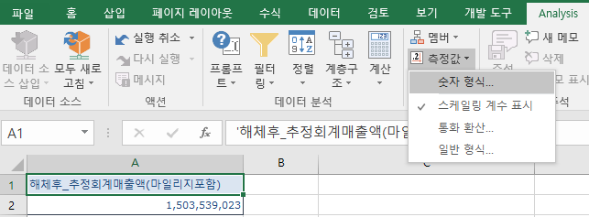

User Manual
Number Format / Scaling
- Choose measure line which you need to change display option.
- Go to Analysis > Measures > Number Format
- Change “Scaling Factor”, “Decimal Places” option
* If you change scaling factor by using this menu, scaling factor in prompts should be entered as 1.

Slide 18
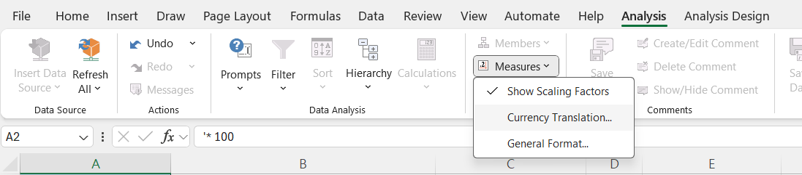
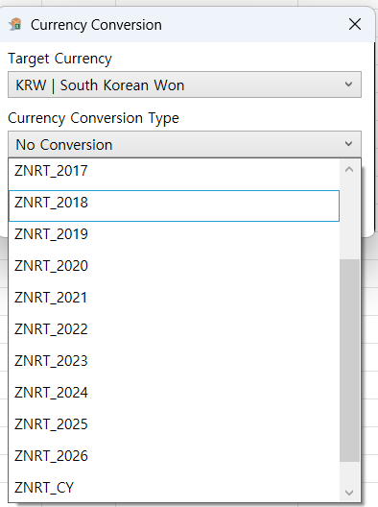



User Manual
Currency Translation
Go to Analysis > Measures > Currency Translation
You can choose “Target currency” & “Currency Conversion Type”
* Local Currency → KRW conversion only supported.
* If you change currency conversion with this menu, currency condition should be removed in prompts.
If select ZNRT_2026 type (BY26 rate) (1 SGD = 1,058 KRW)
If select ZNRT_2025 type (BY25 rate) (1 SGD = 1,002 KRW)

Slide 19
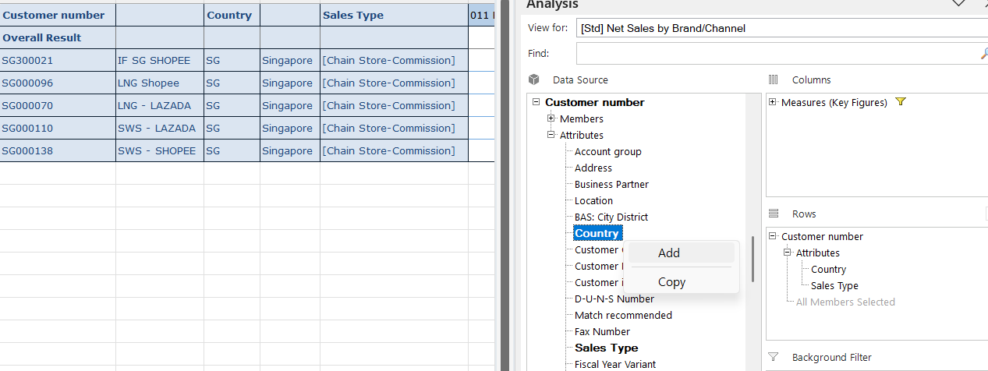
User Manual
Master Characteristic
If a characteristic have a master data, you can add its components as attributes.

Slide 20
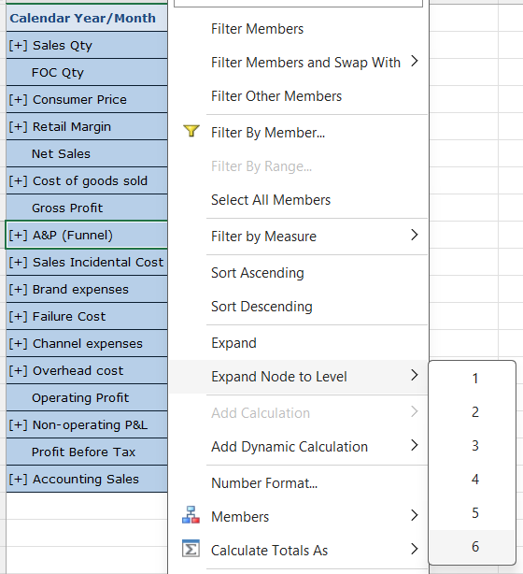
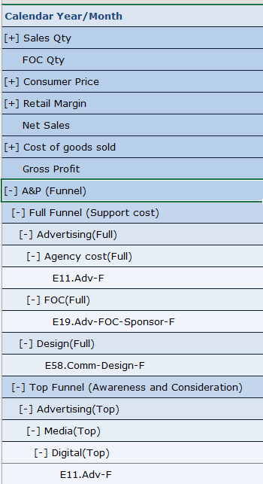
User Manual
Expand Node to Level
In case of New P&L report, Measure is shown as structure with hierarchy level.
User should expand node manually to check sub-level data.
“Expand Node to Level” menu helps user to expand node at once.
[Option] Right Click on node with [ + ] label > Expand Node to Level > Select Level.
* If you choose the largest number, all structure will be expanded for selected node.

Slide 21
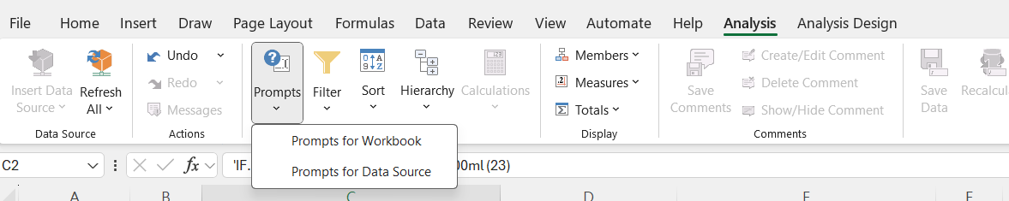
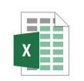
User Manual
Save & Refresh
You can save SAP BI file just like excel file.
Next time when you refresh BI file, just click “Refresh All” or Click “Prompts” button and update condition.
Prompts Option
Prompts for Workbook : Check All report prompts in excel file.
Prompts for Data Source : Check specific report prompts in selected cell.

Slide 22
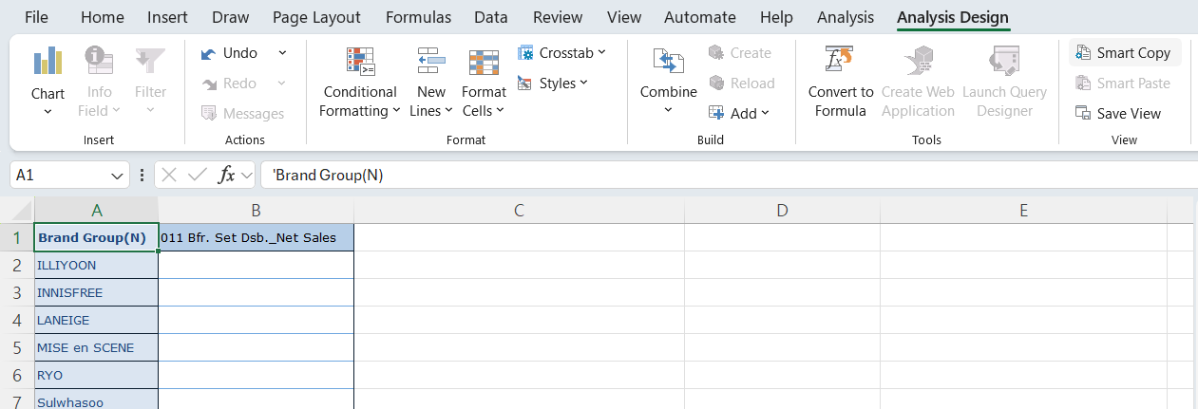
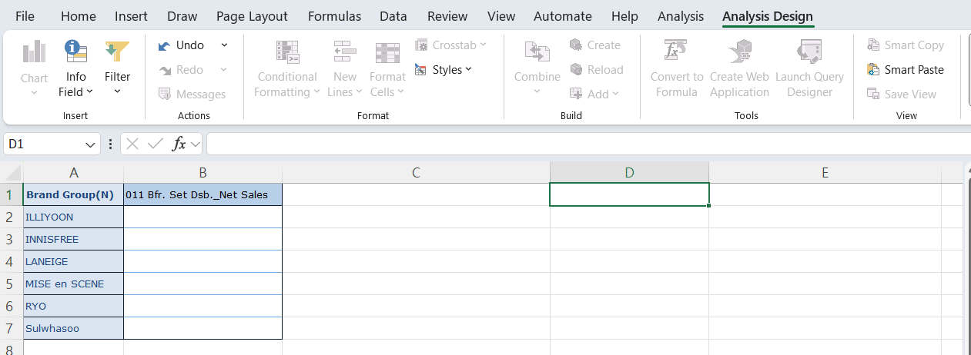
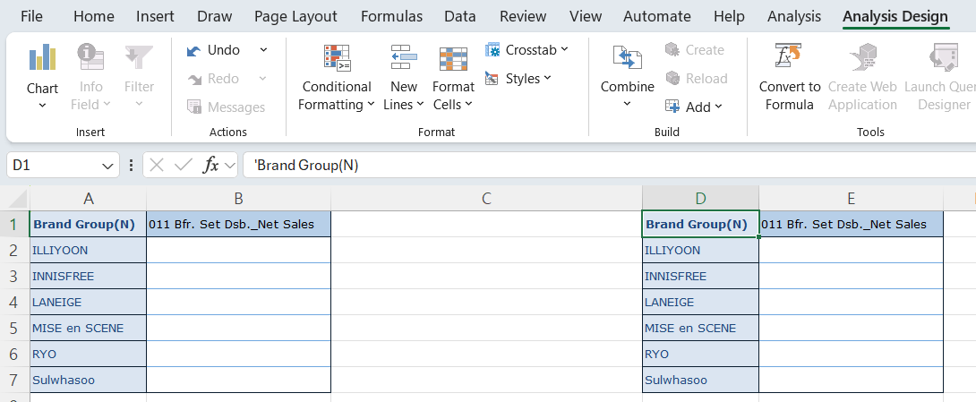
User Manual
Smart Copy & Smart Paste
If you need to insert BI report with same condition but different layout, you can copy it easily with smart copy & paste function.
[Option]
Choose BI report you want to copy.
Go to Analysis Design > Smart Copy
Choose excel cell you want to paste.
Go to Analysis Design > Smart Paste

Slide 23
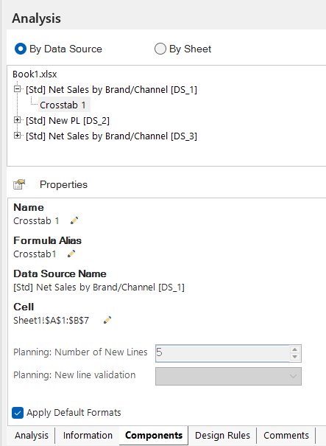
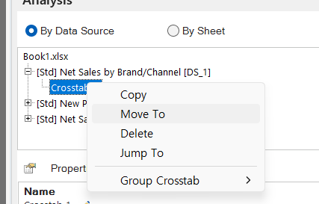
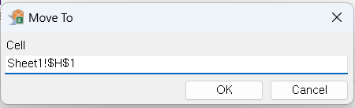
User Manual
Delete / Move BI Report
Change Report Position
Go to “Components” tab
Expand + button on BI report.
Click “Crosstab” node, then you can check cell position of selected report.
Right Click on “Crosstab” > “Move To”
Input new position.

Slide 24
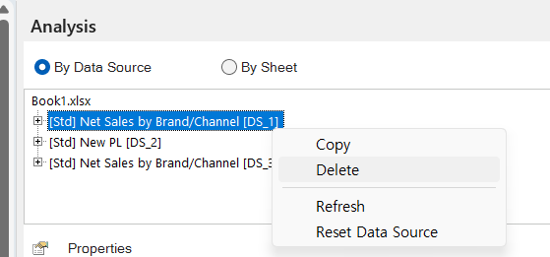
User Manual
Delete / Move BI Report
Delete Report
Go to “Components” tab
Right Click on BI report name > “Delete”

