Slide 1
MM_How to modify a purchase order in ME22N

Slide 2
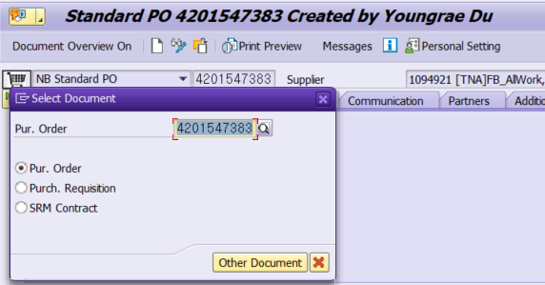

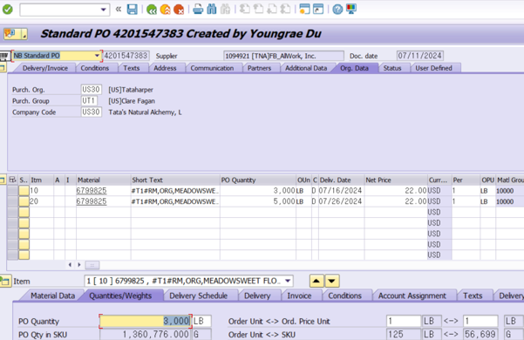

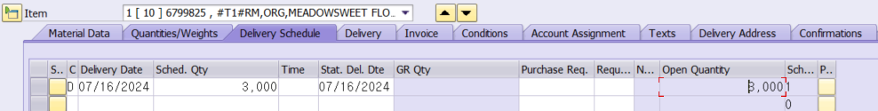
Change Purchase Order (T-code: ME22N)
6.6.1.14 Manual Purchase Requisition-TNA
Screen
Explanation
[Change PO]
A transaction to change the PO by checking the change in delivery date and quantity requested by the vendor
Move to the number of PO to be changed
- Click or press Shift+F5 to input the PO number and click on Other Document button.
Click to switch to PO change mode.
- Users can change the purchase document using the Display/Change button in the ME22N or ME23N transaction but must know the PO number that needs to be changed before using the transaction.
After checking the PO information in the item section, edit the detail that needs to be changed.
- This can also be reflected by modifying the information in the delivery schedule tab of the item detail.
Click Save button to change PO.
2
1
4
3

